Slide 1

Robot for cleaning building facades
Henrik Leivestad
Knut Wilhelm Omholt Saatvedt
Christopher Wallem Veland

Slide 2
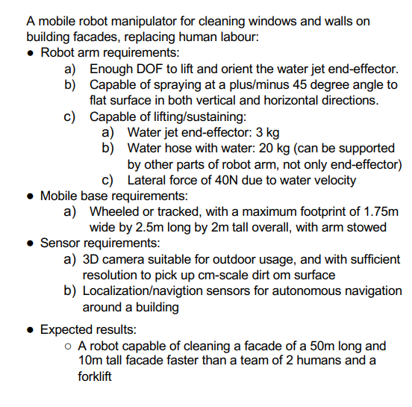
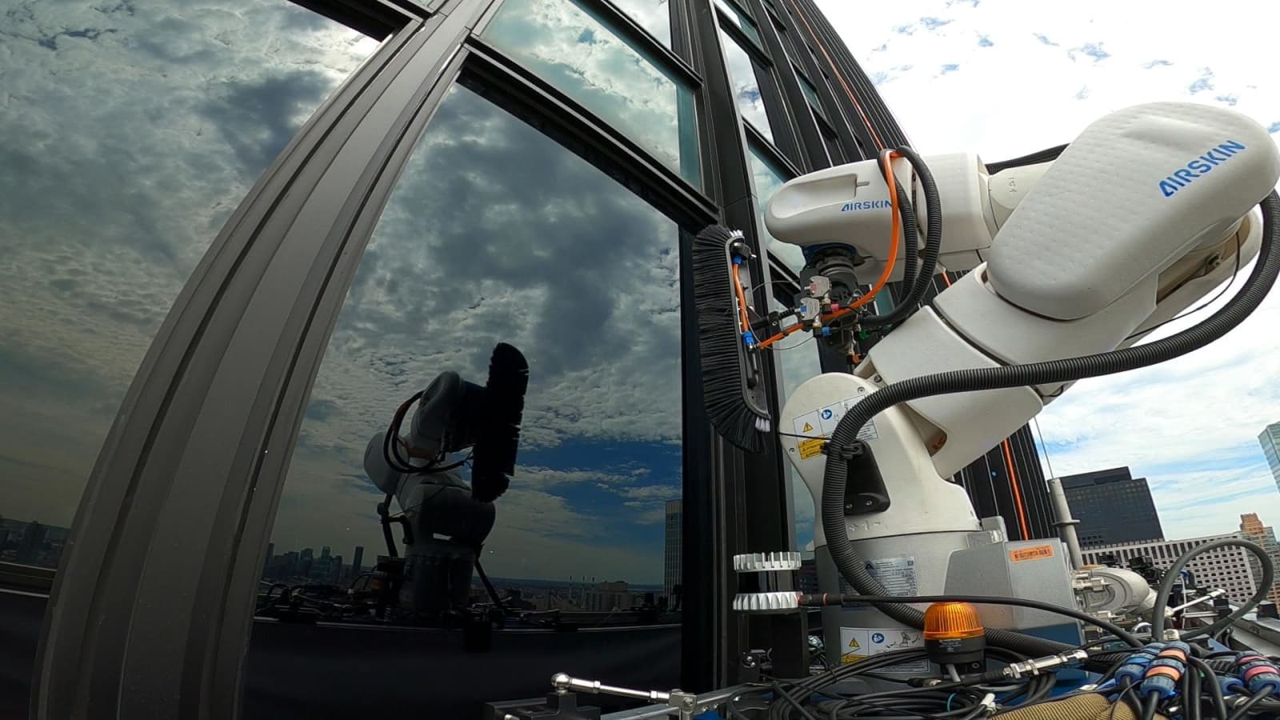
Robot for cleaning building facades

Slide 3
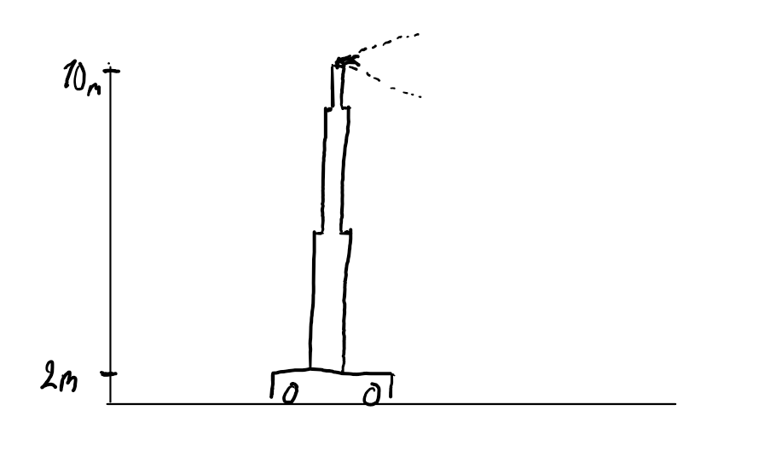
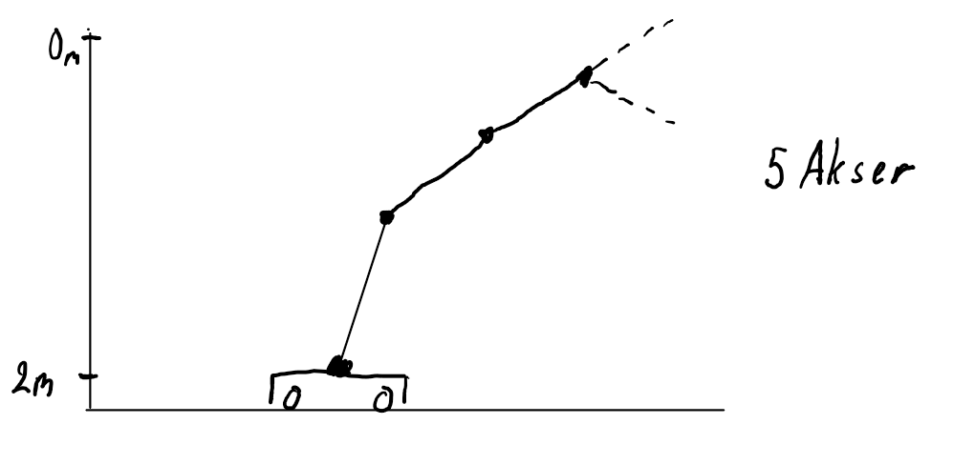
Our designs

Slide 4
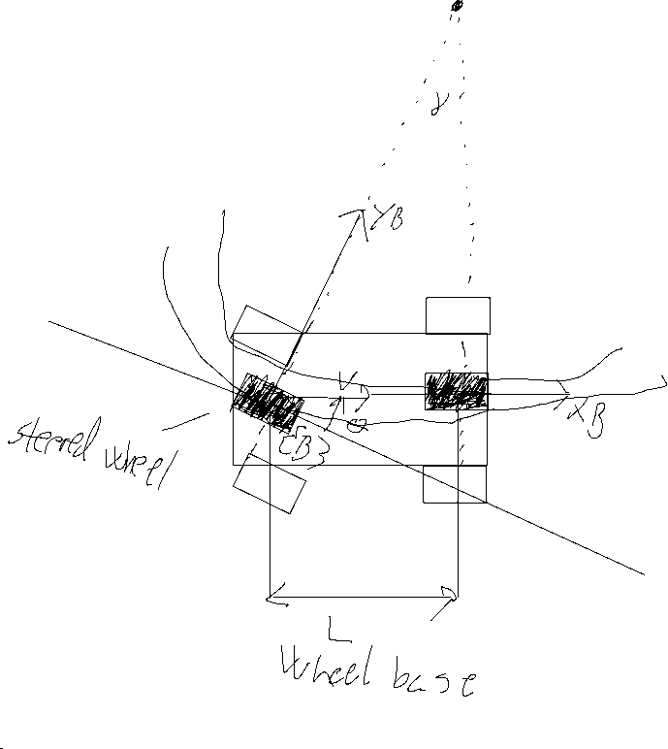
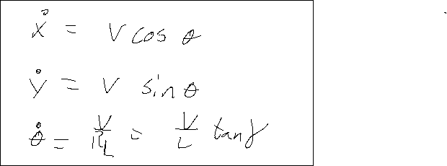
Bicycle model
Back wheel drive
Back wheel steering

